Slide 1
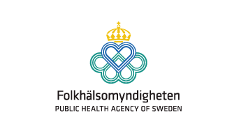
Data analysis :The Covid-19 Pandemic in Sweden
David Wullimann
2024-02-19

Slide 2
Agenda
Cases
Intensive care unit (ICU) and Death
Vaccination coverage
Excess mortality (SCB Statistics Sweden)
The Pandemic in 2024

Slide 3

Agenda
Cases
ICU and Death
Vaccination
Excess mortality
The Pandemic in 2024

Slide 4
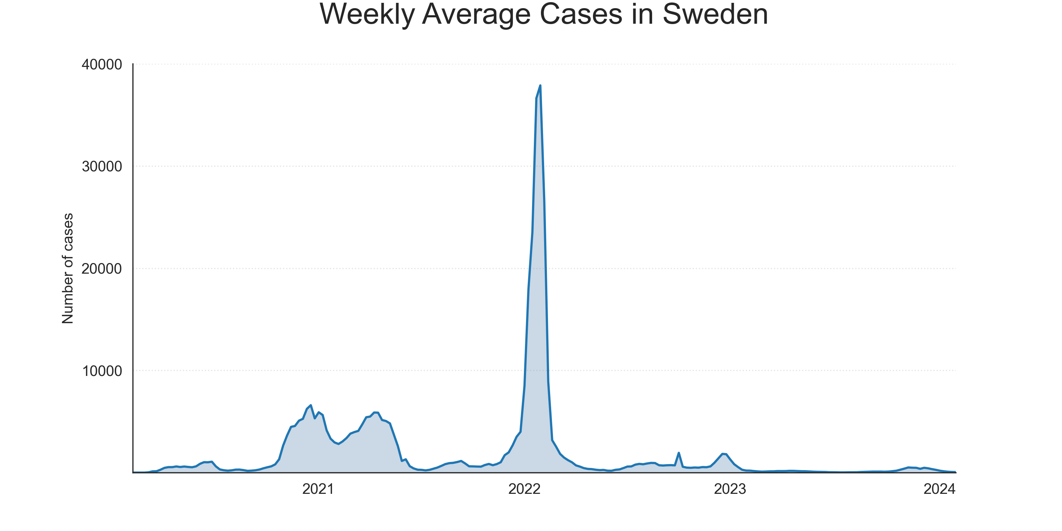
Data
Timeline: 2020-02-04 to 2024-02-04

Slide 5
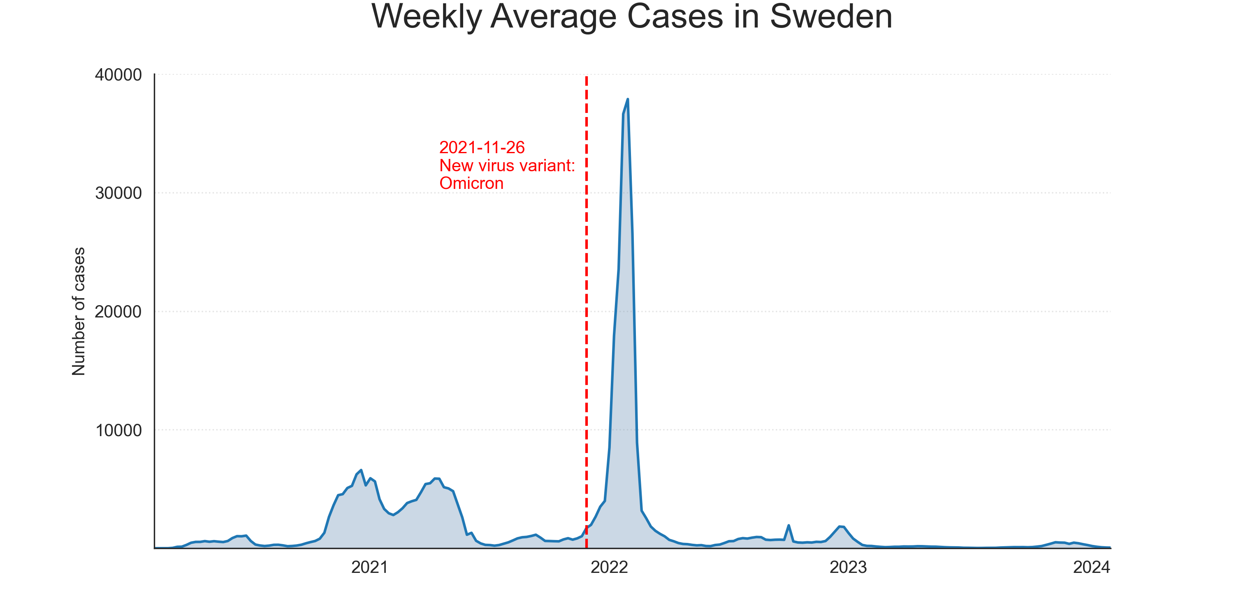
Data
Timeline: 2020-02-04 to 2024-02-04

Slide 6
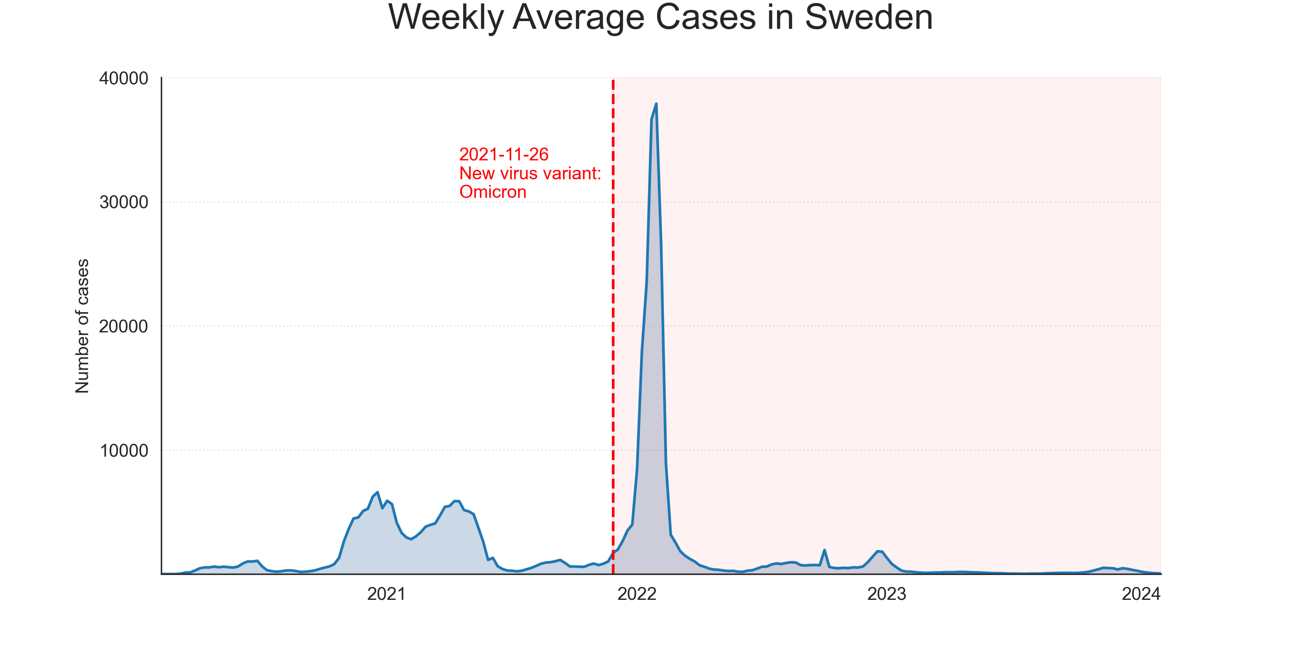
Data
Timeline: 2020-02-04 to 2024-02-04

Slide 7
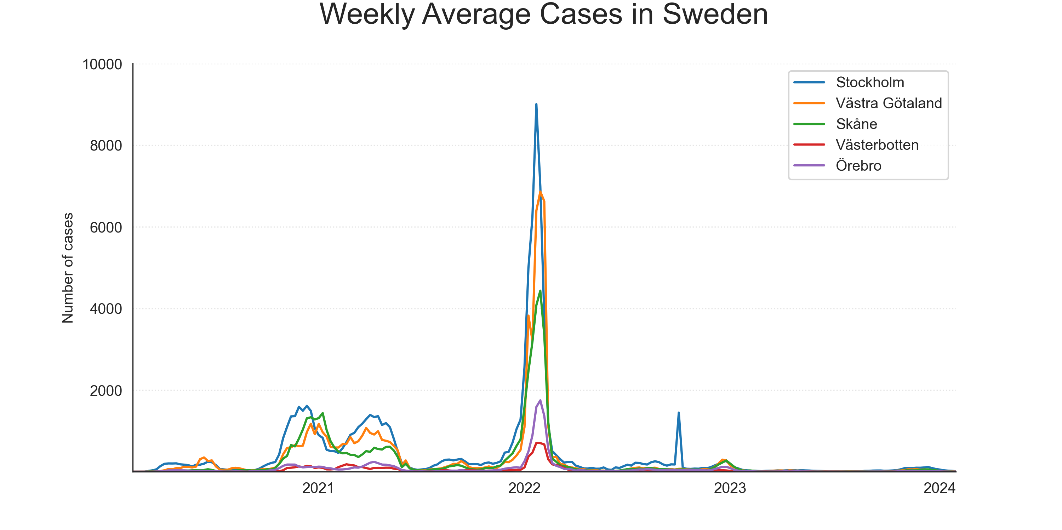
Data
Timeline: 2020-02-04 to 2024-02-04

Slide 8
Data
Timeline: 2020-02-04 to 2024-02-04

Slide 9
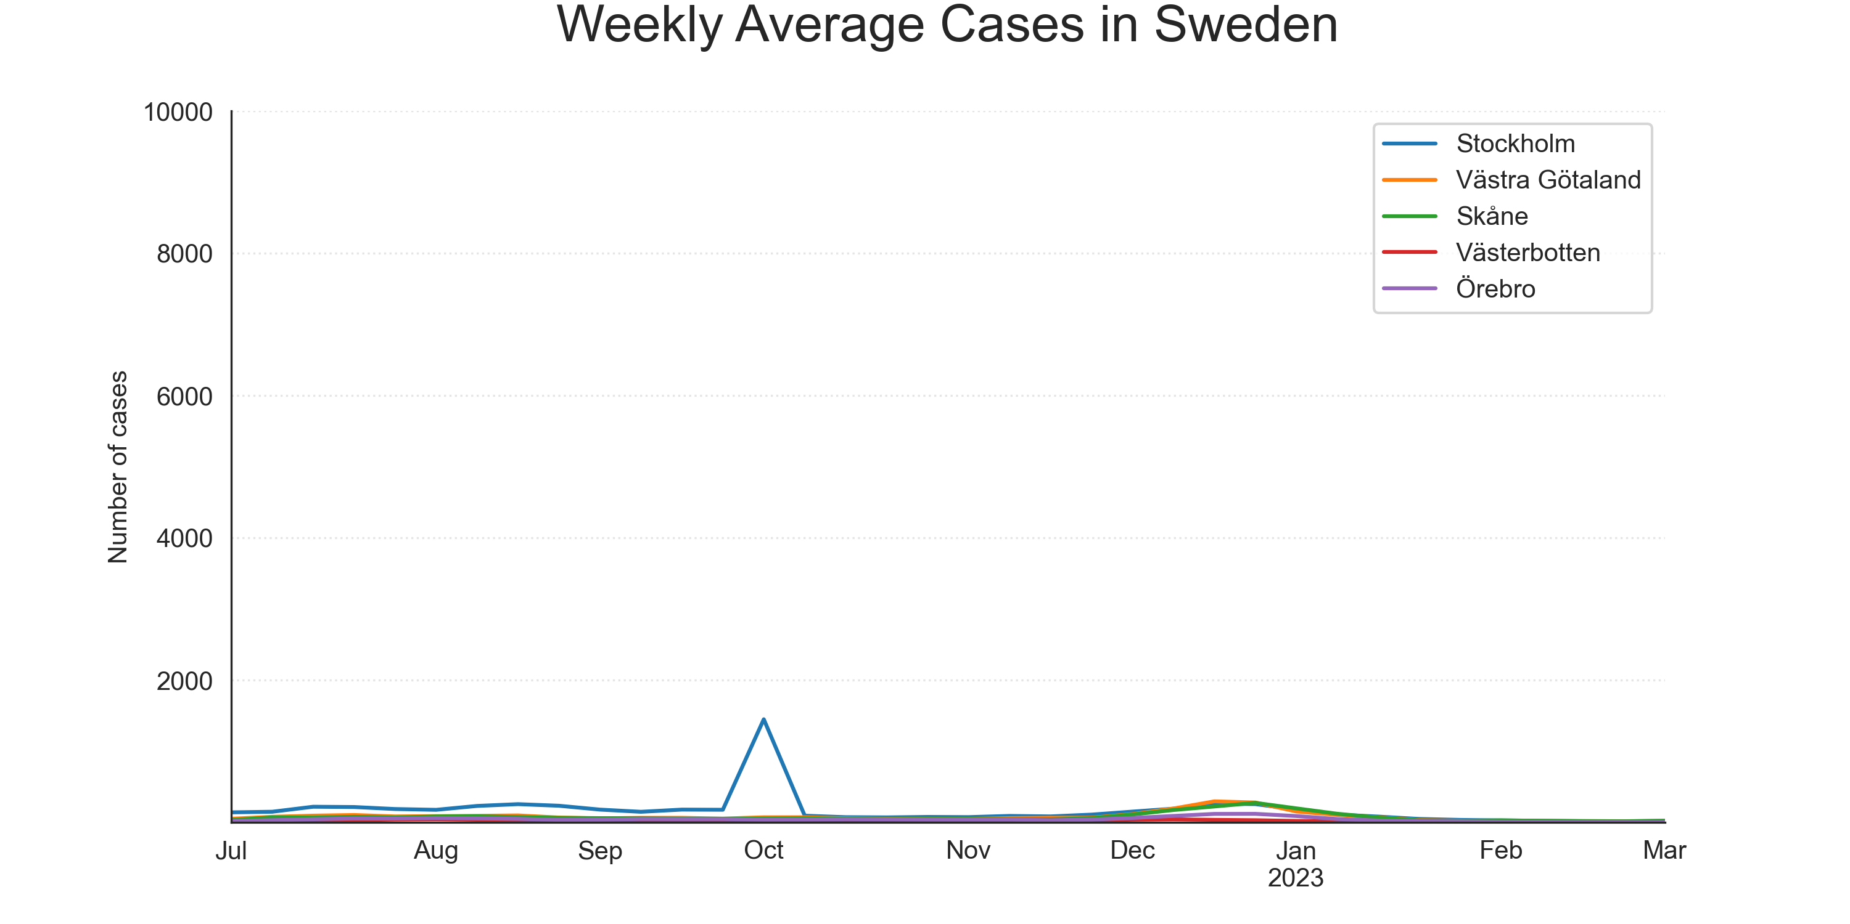
Data
Timeline: 2020-02-04 to 2024-02-04

Slide 10
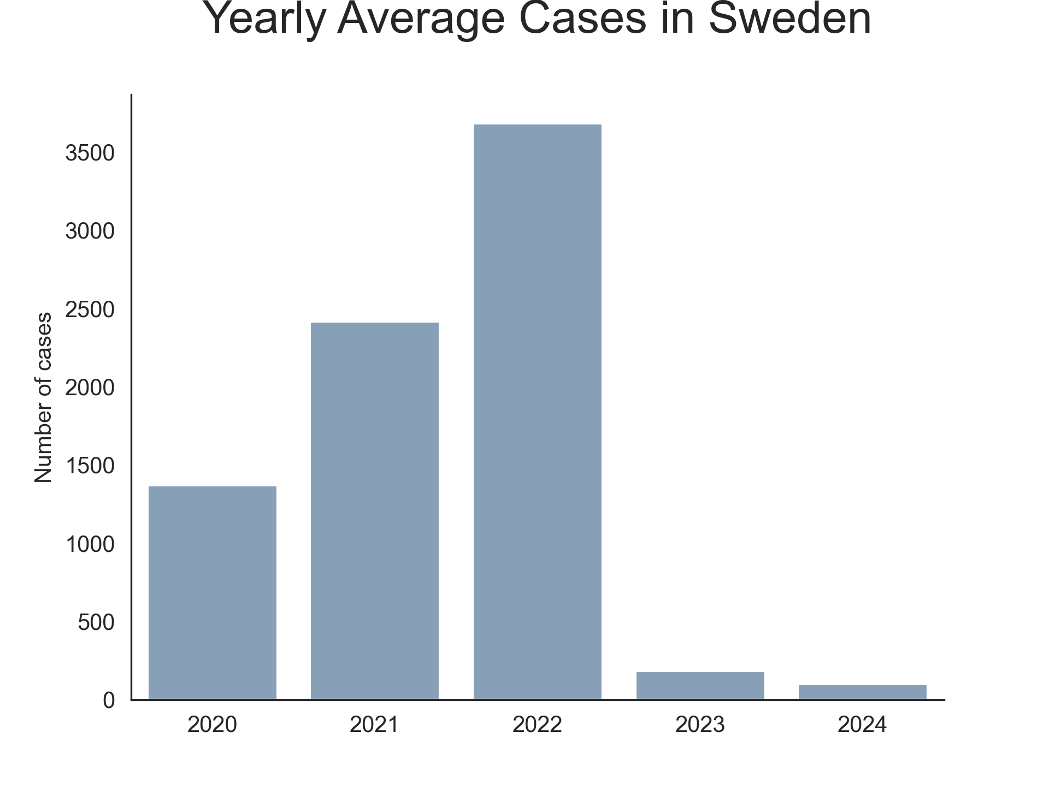
Data

Slide 11
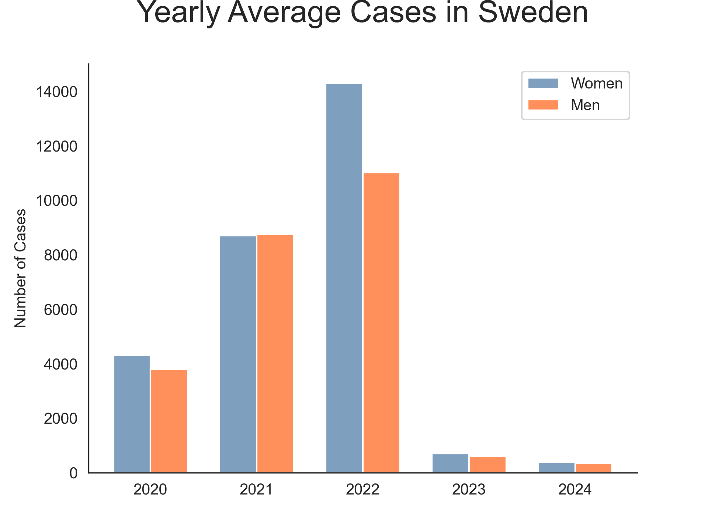
Data

Slide 12
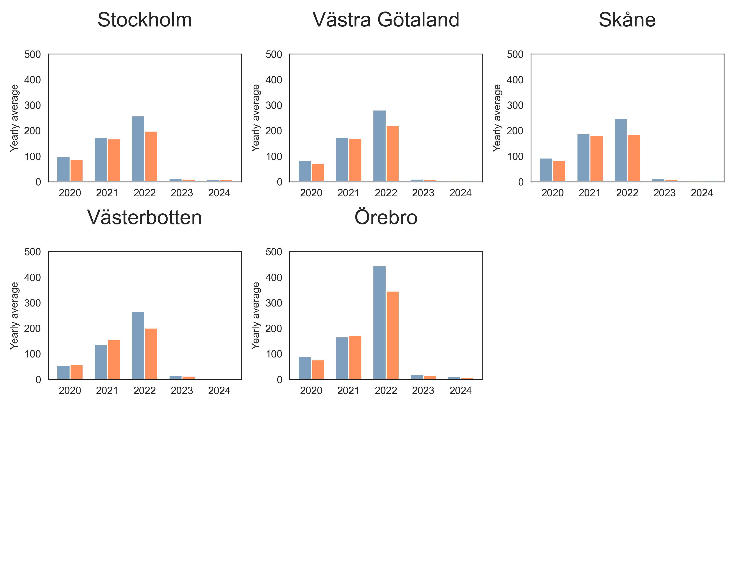
Data

Slide 13
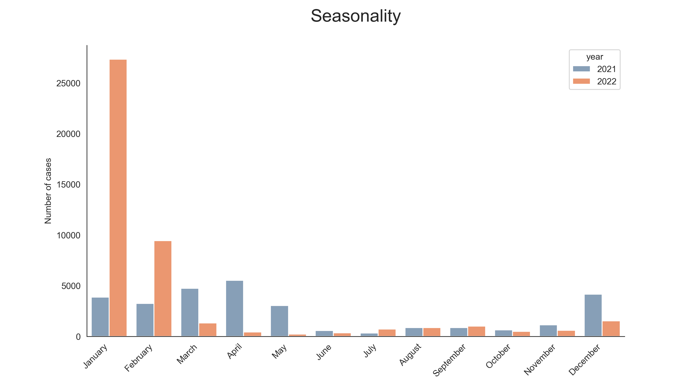
Data

Slide 14

Agenda
Cases
ICU and Death
Vaccination
Excess mortality
The Pandemic in 2024

Slide 15
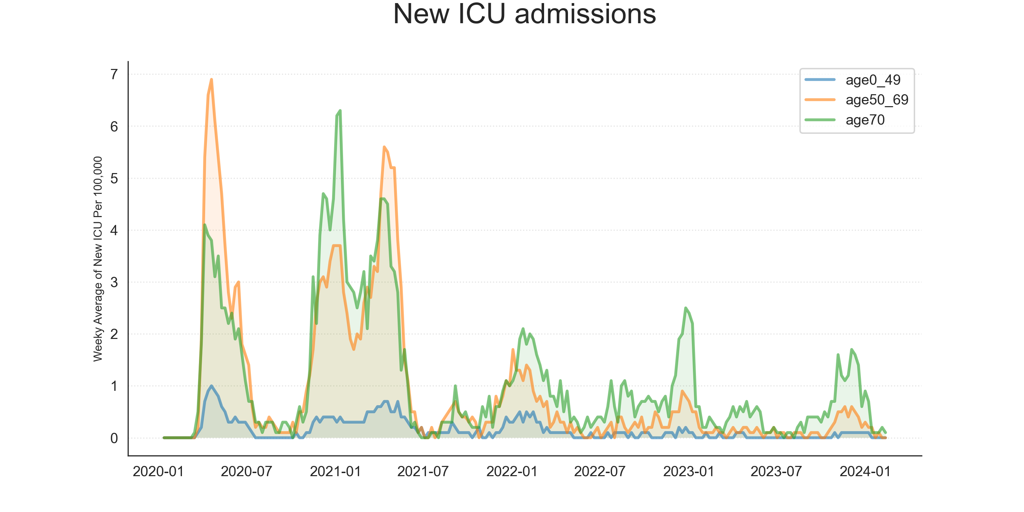
Data

Slide 16
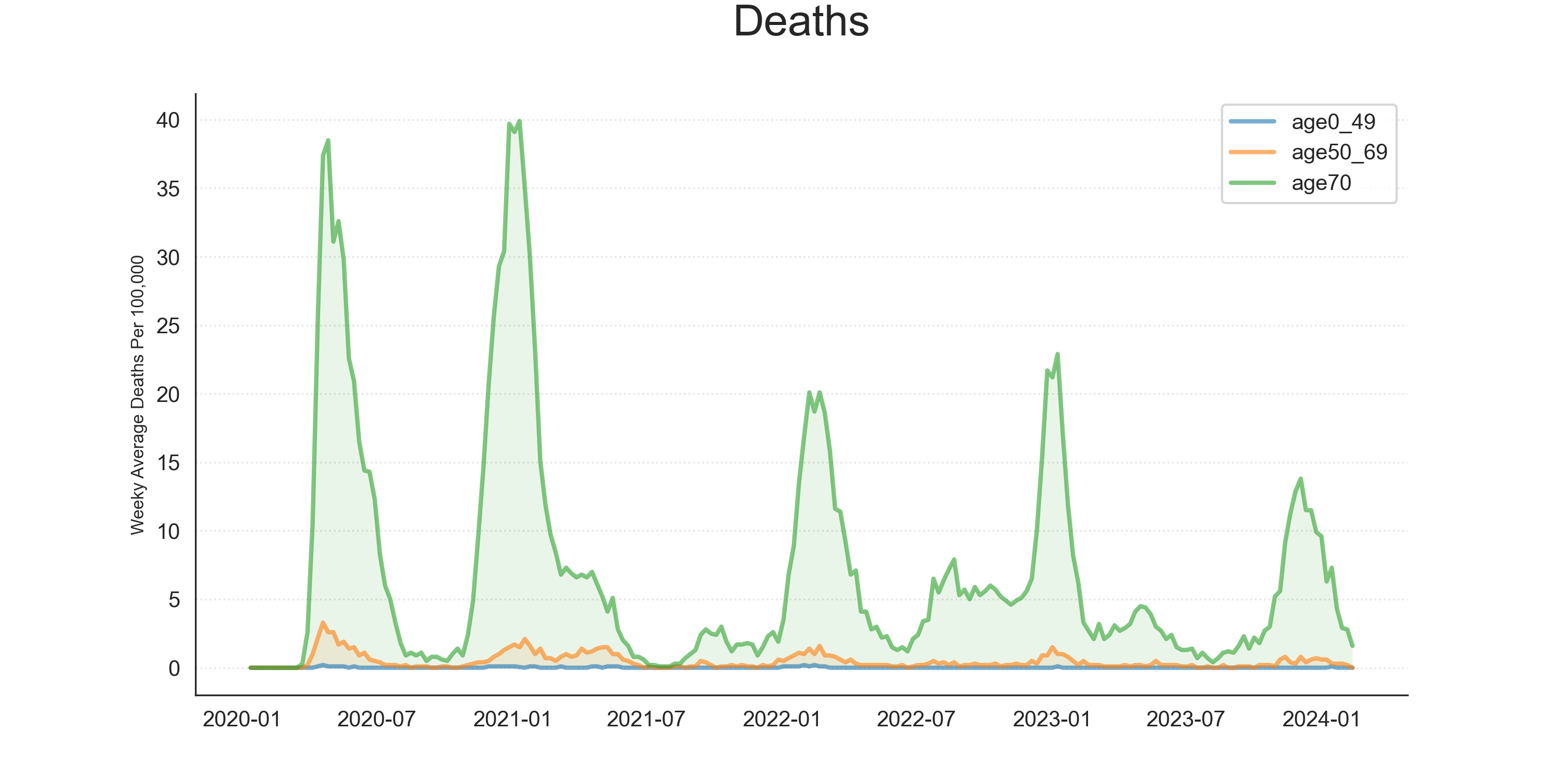
Data

Slide 17
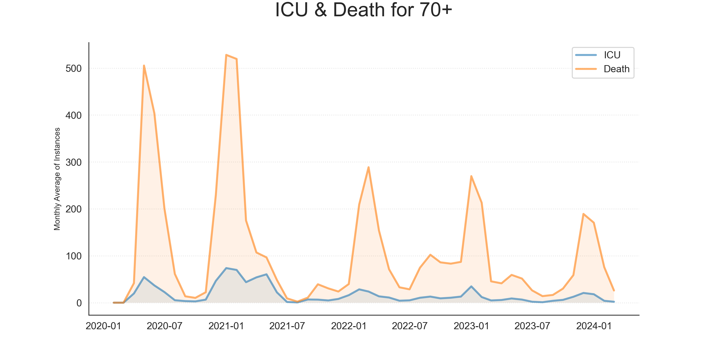
Data

Slide 18
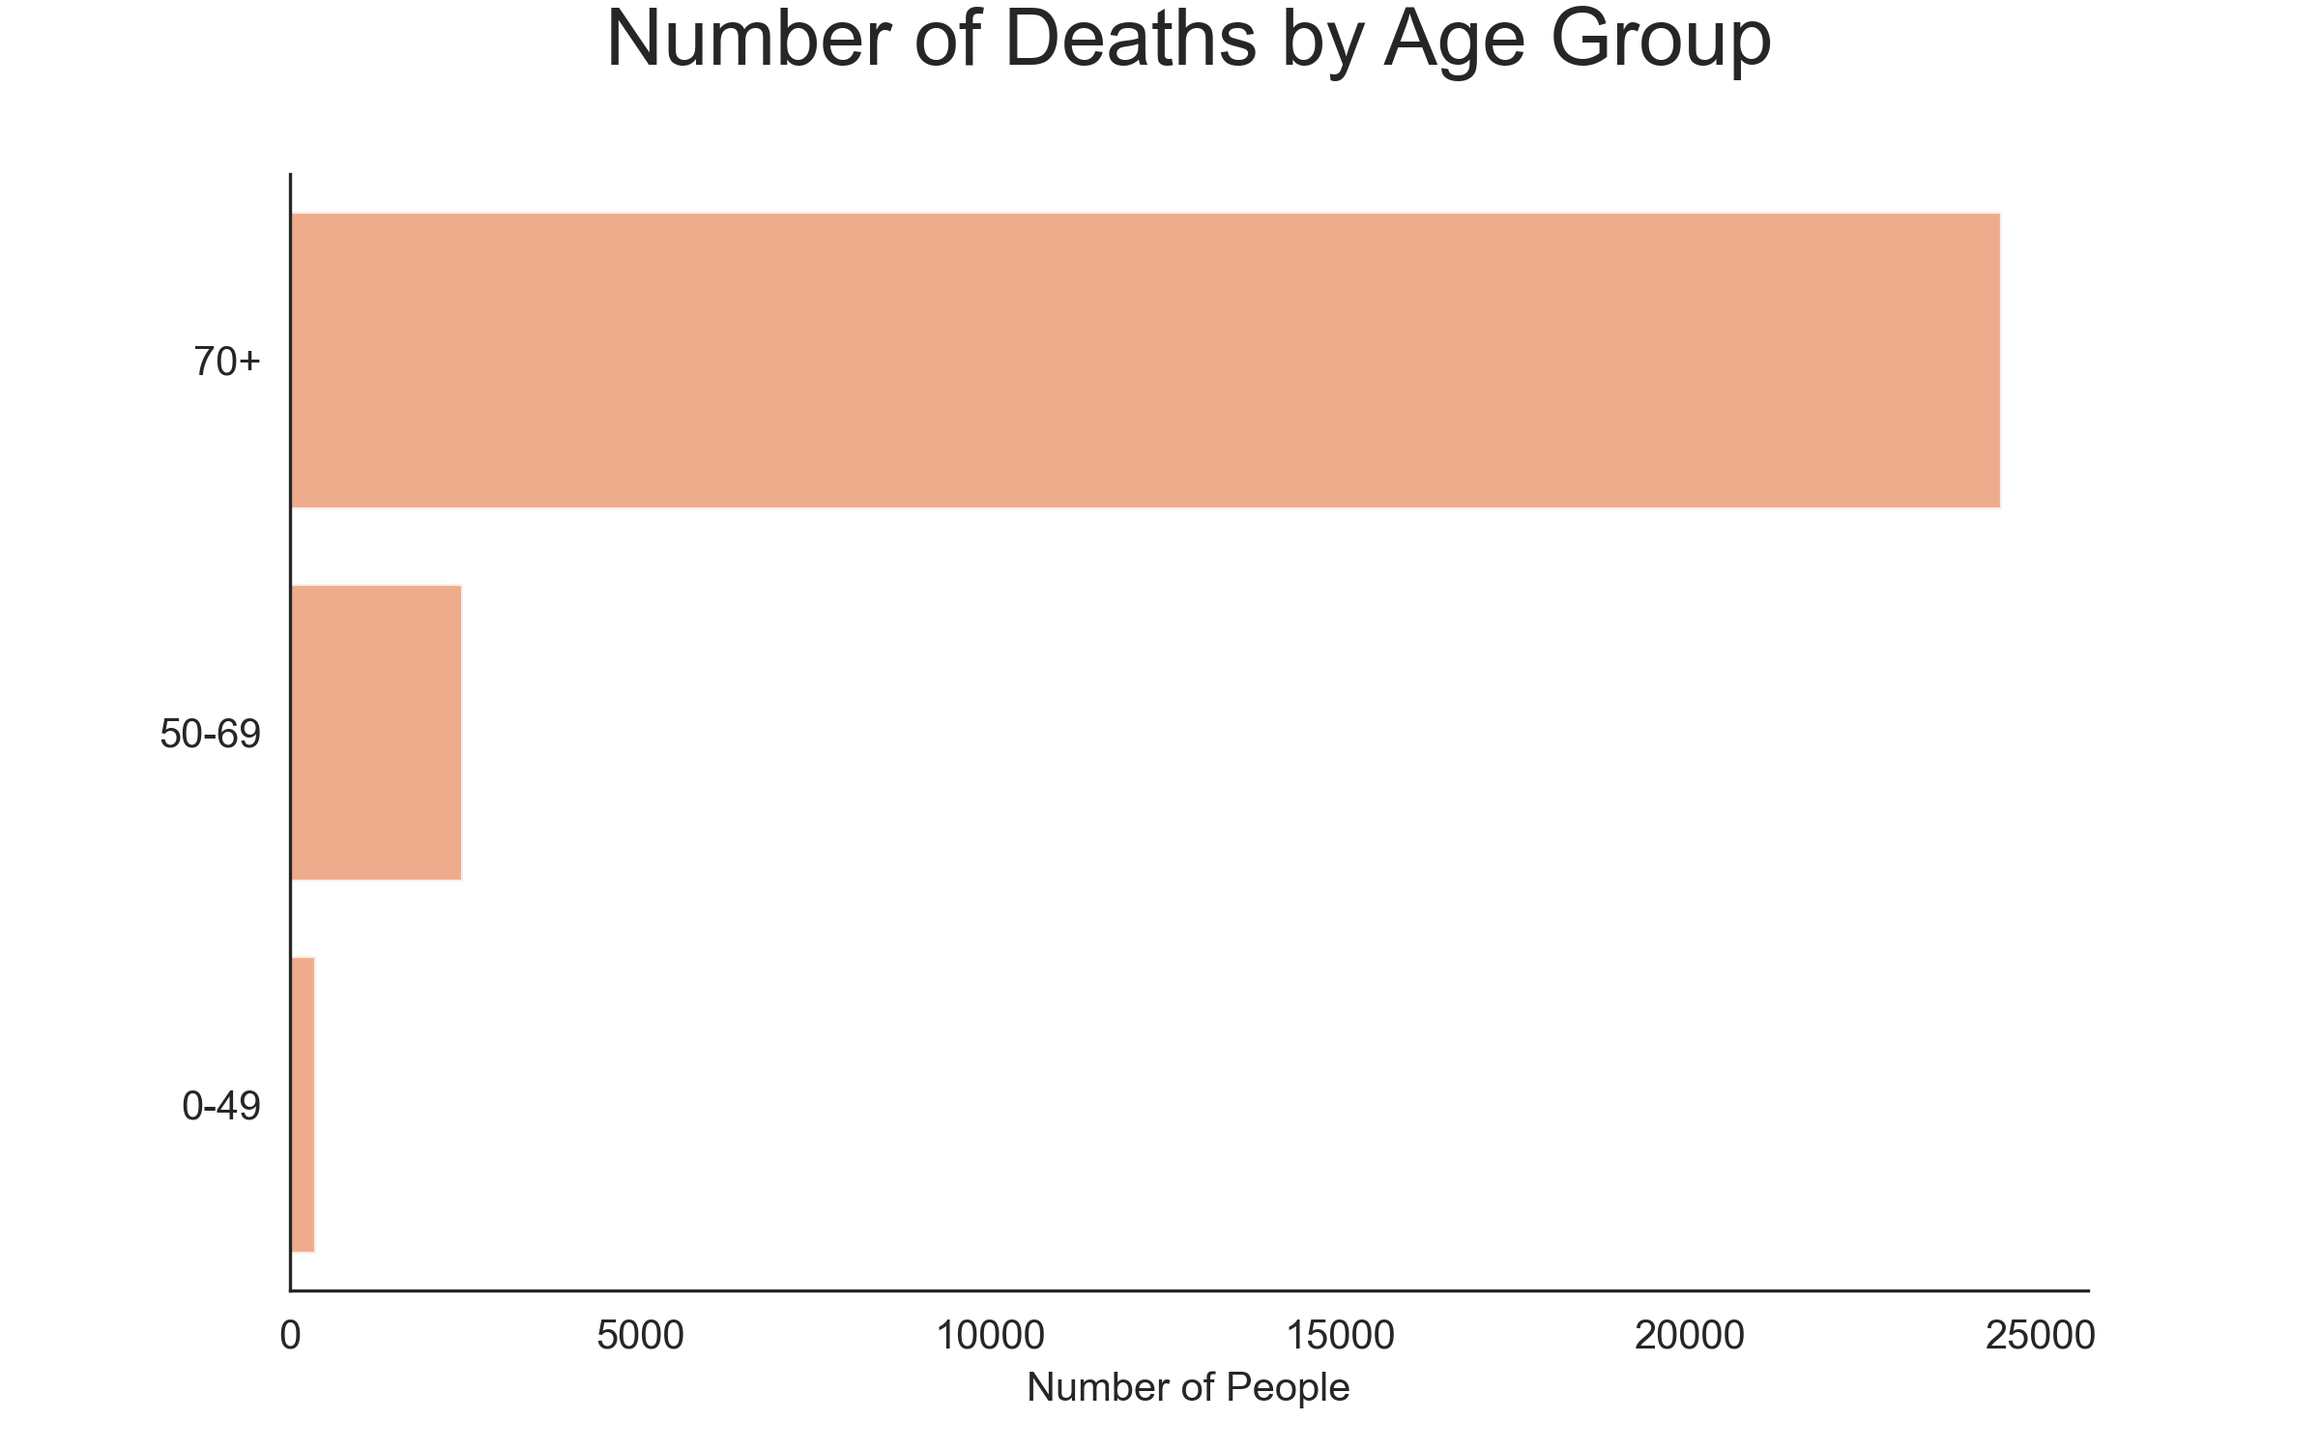
Data
Timeline: 2020-02-04 to 2024-02-04

Slide 19

Agenda
Cases
ICU and Death
Vaccination
Excess mortality
The Pandemic in 2024

Slide 20
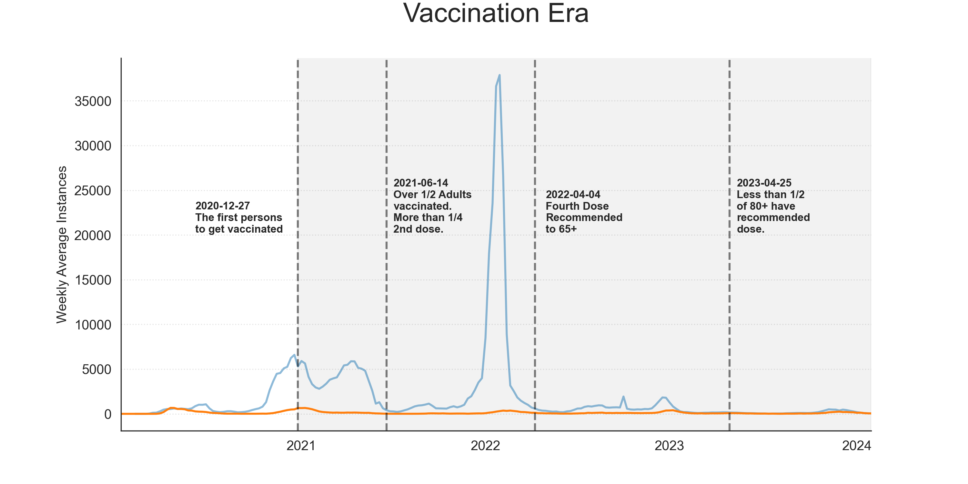
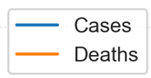
Data

Slide 21
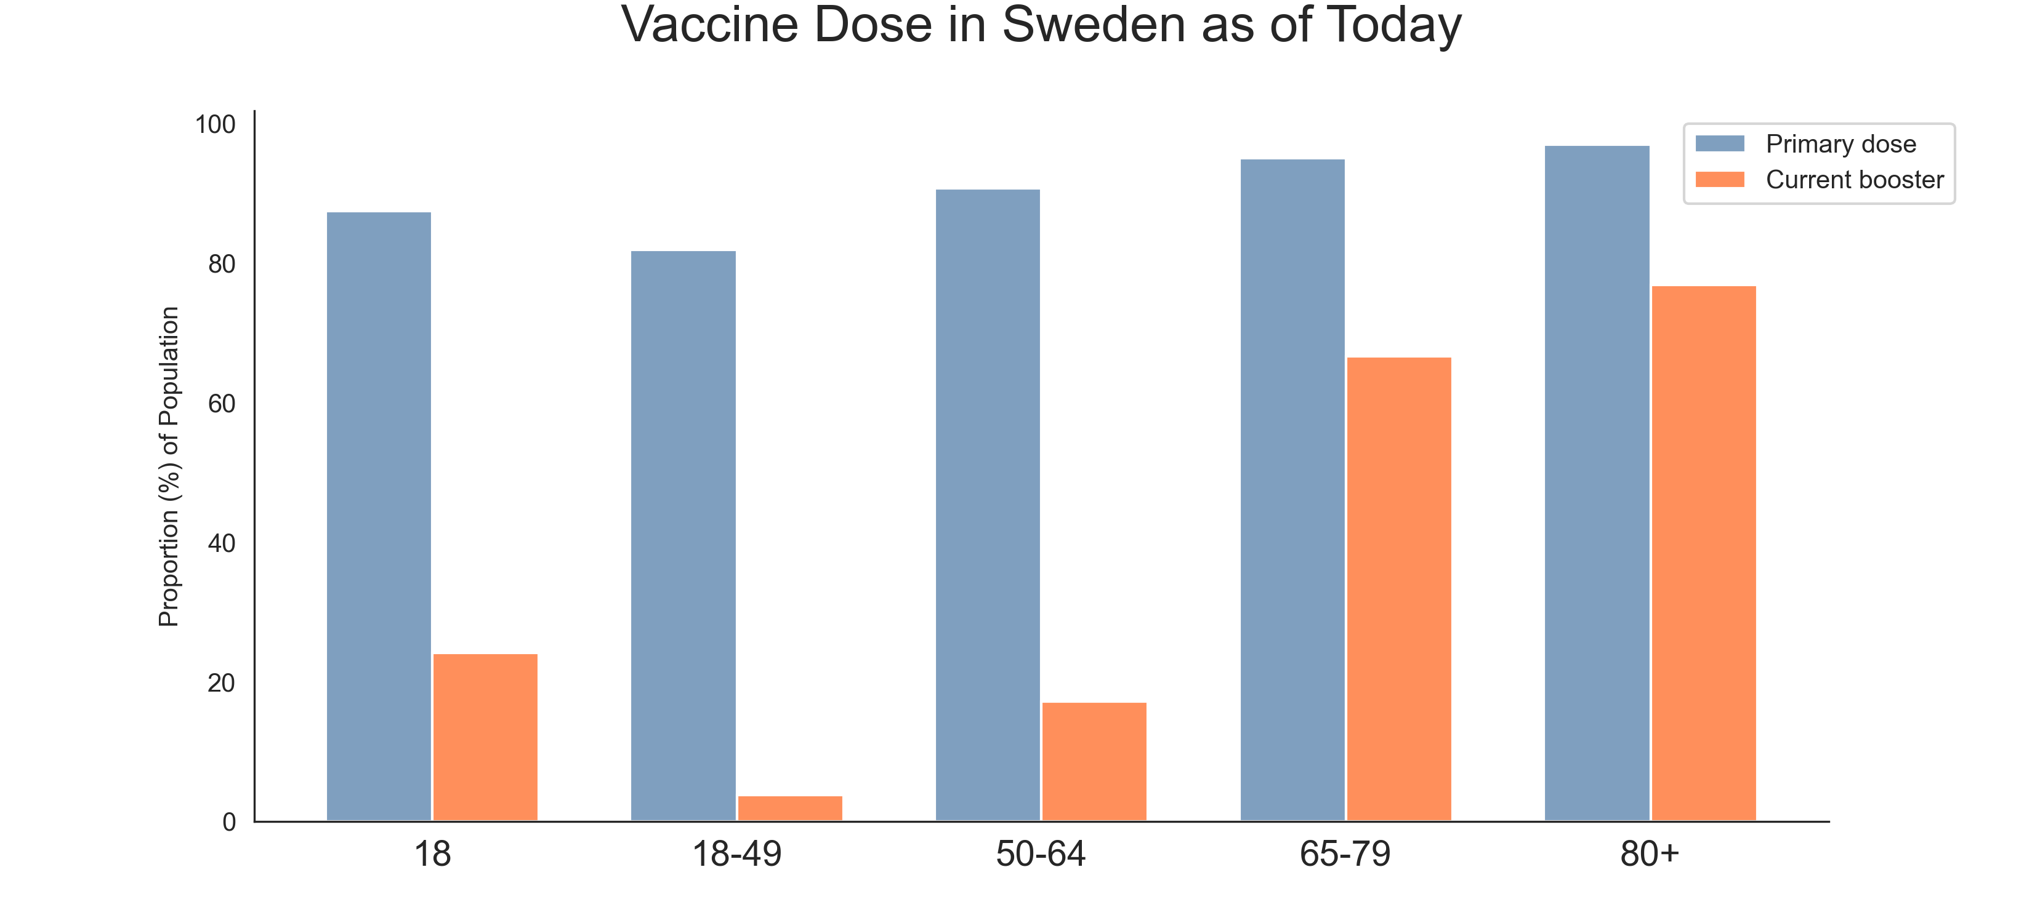
Data

Slide 22
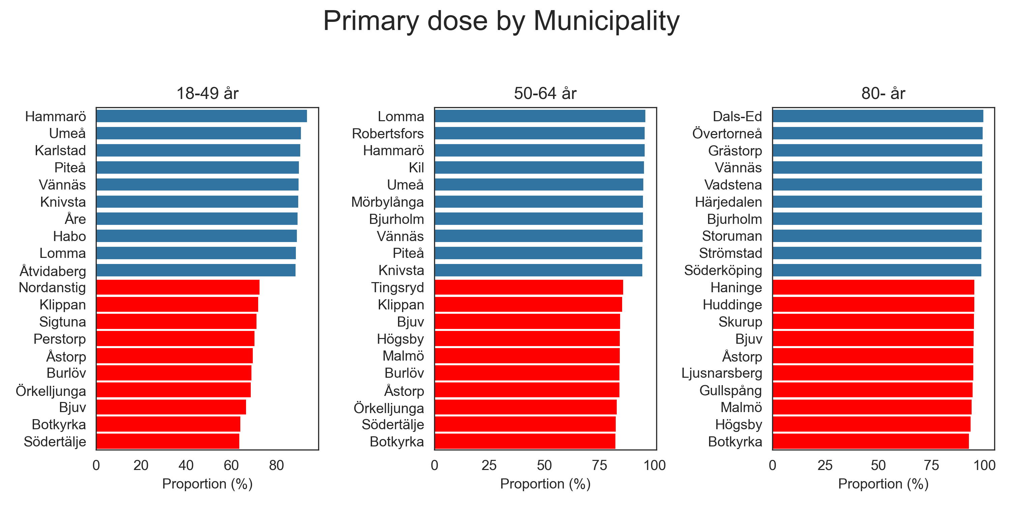
Data

Slide 23
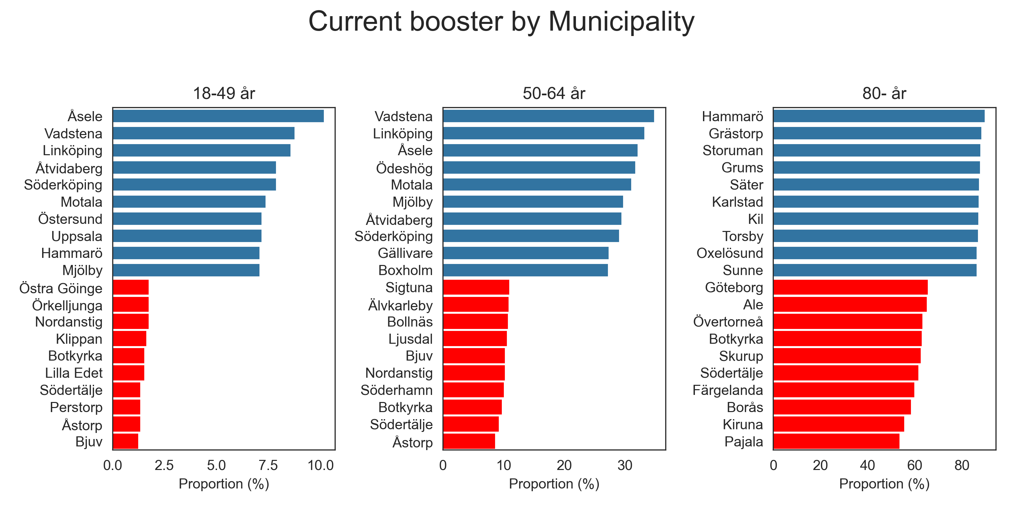
Data

Slide 24
Agenda
Cases
ICU and Death
Vaccination
Excess mortality
The Pandemic in 2024

Slide 25
Excess Mortality
The average number of death (all causes) of each month between 2015-2019 (pre-pandemic) compared to each month of 2020 to 2023-11

Slide 26
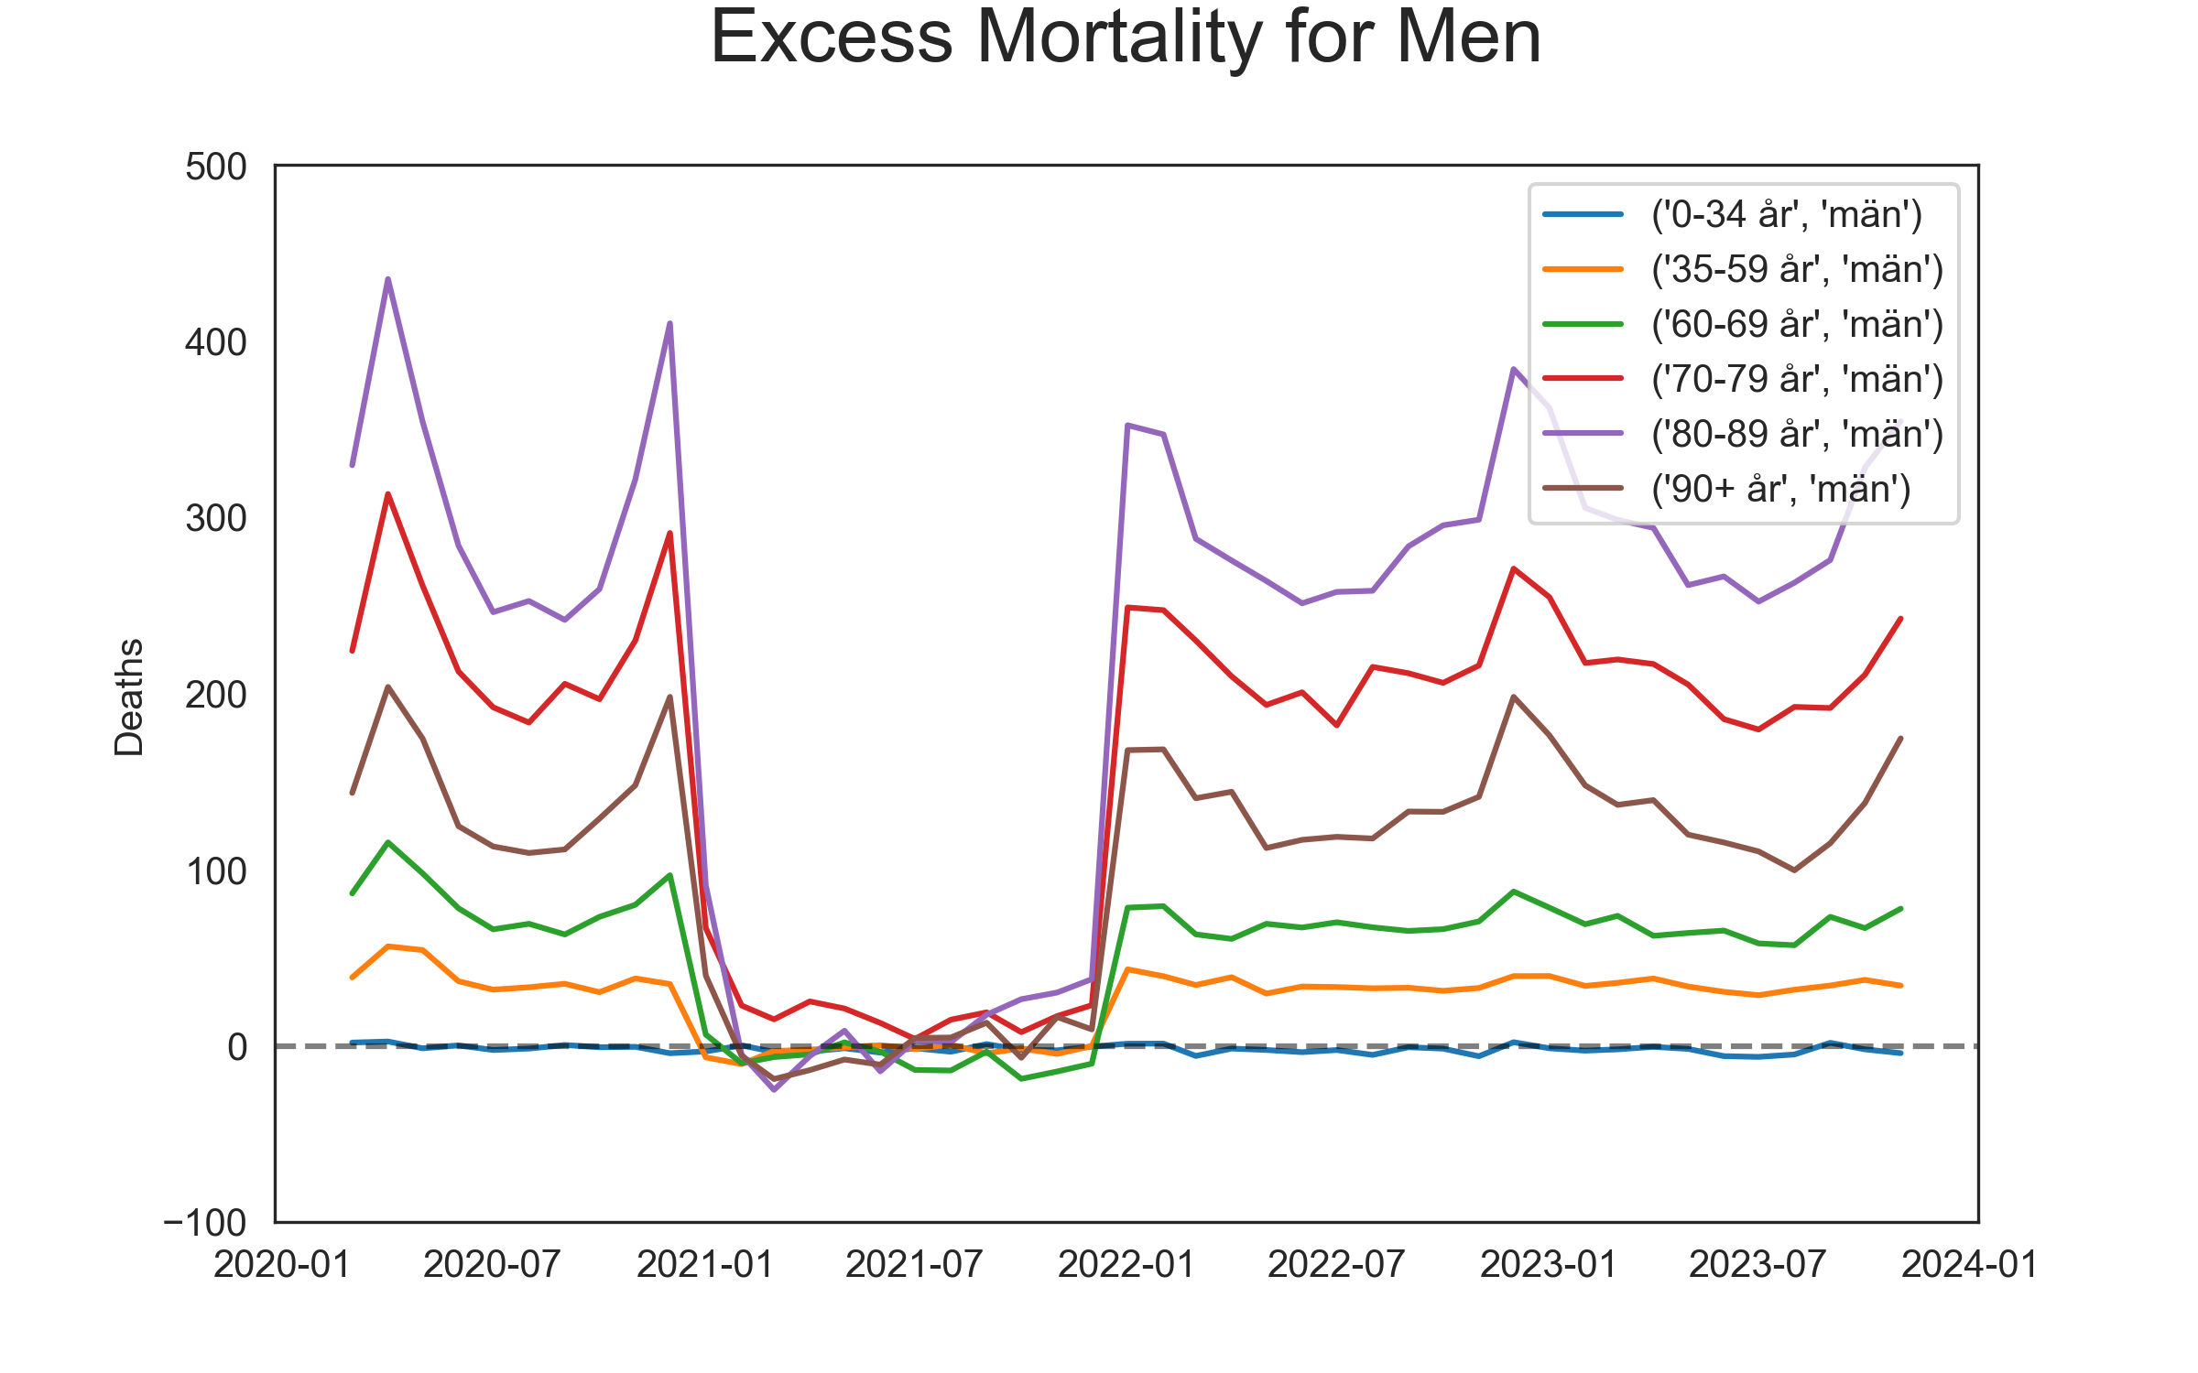
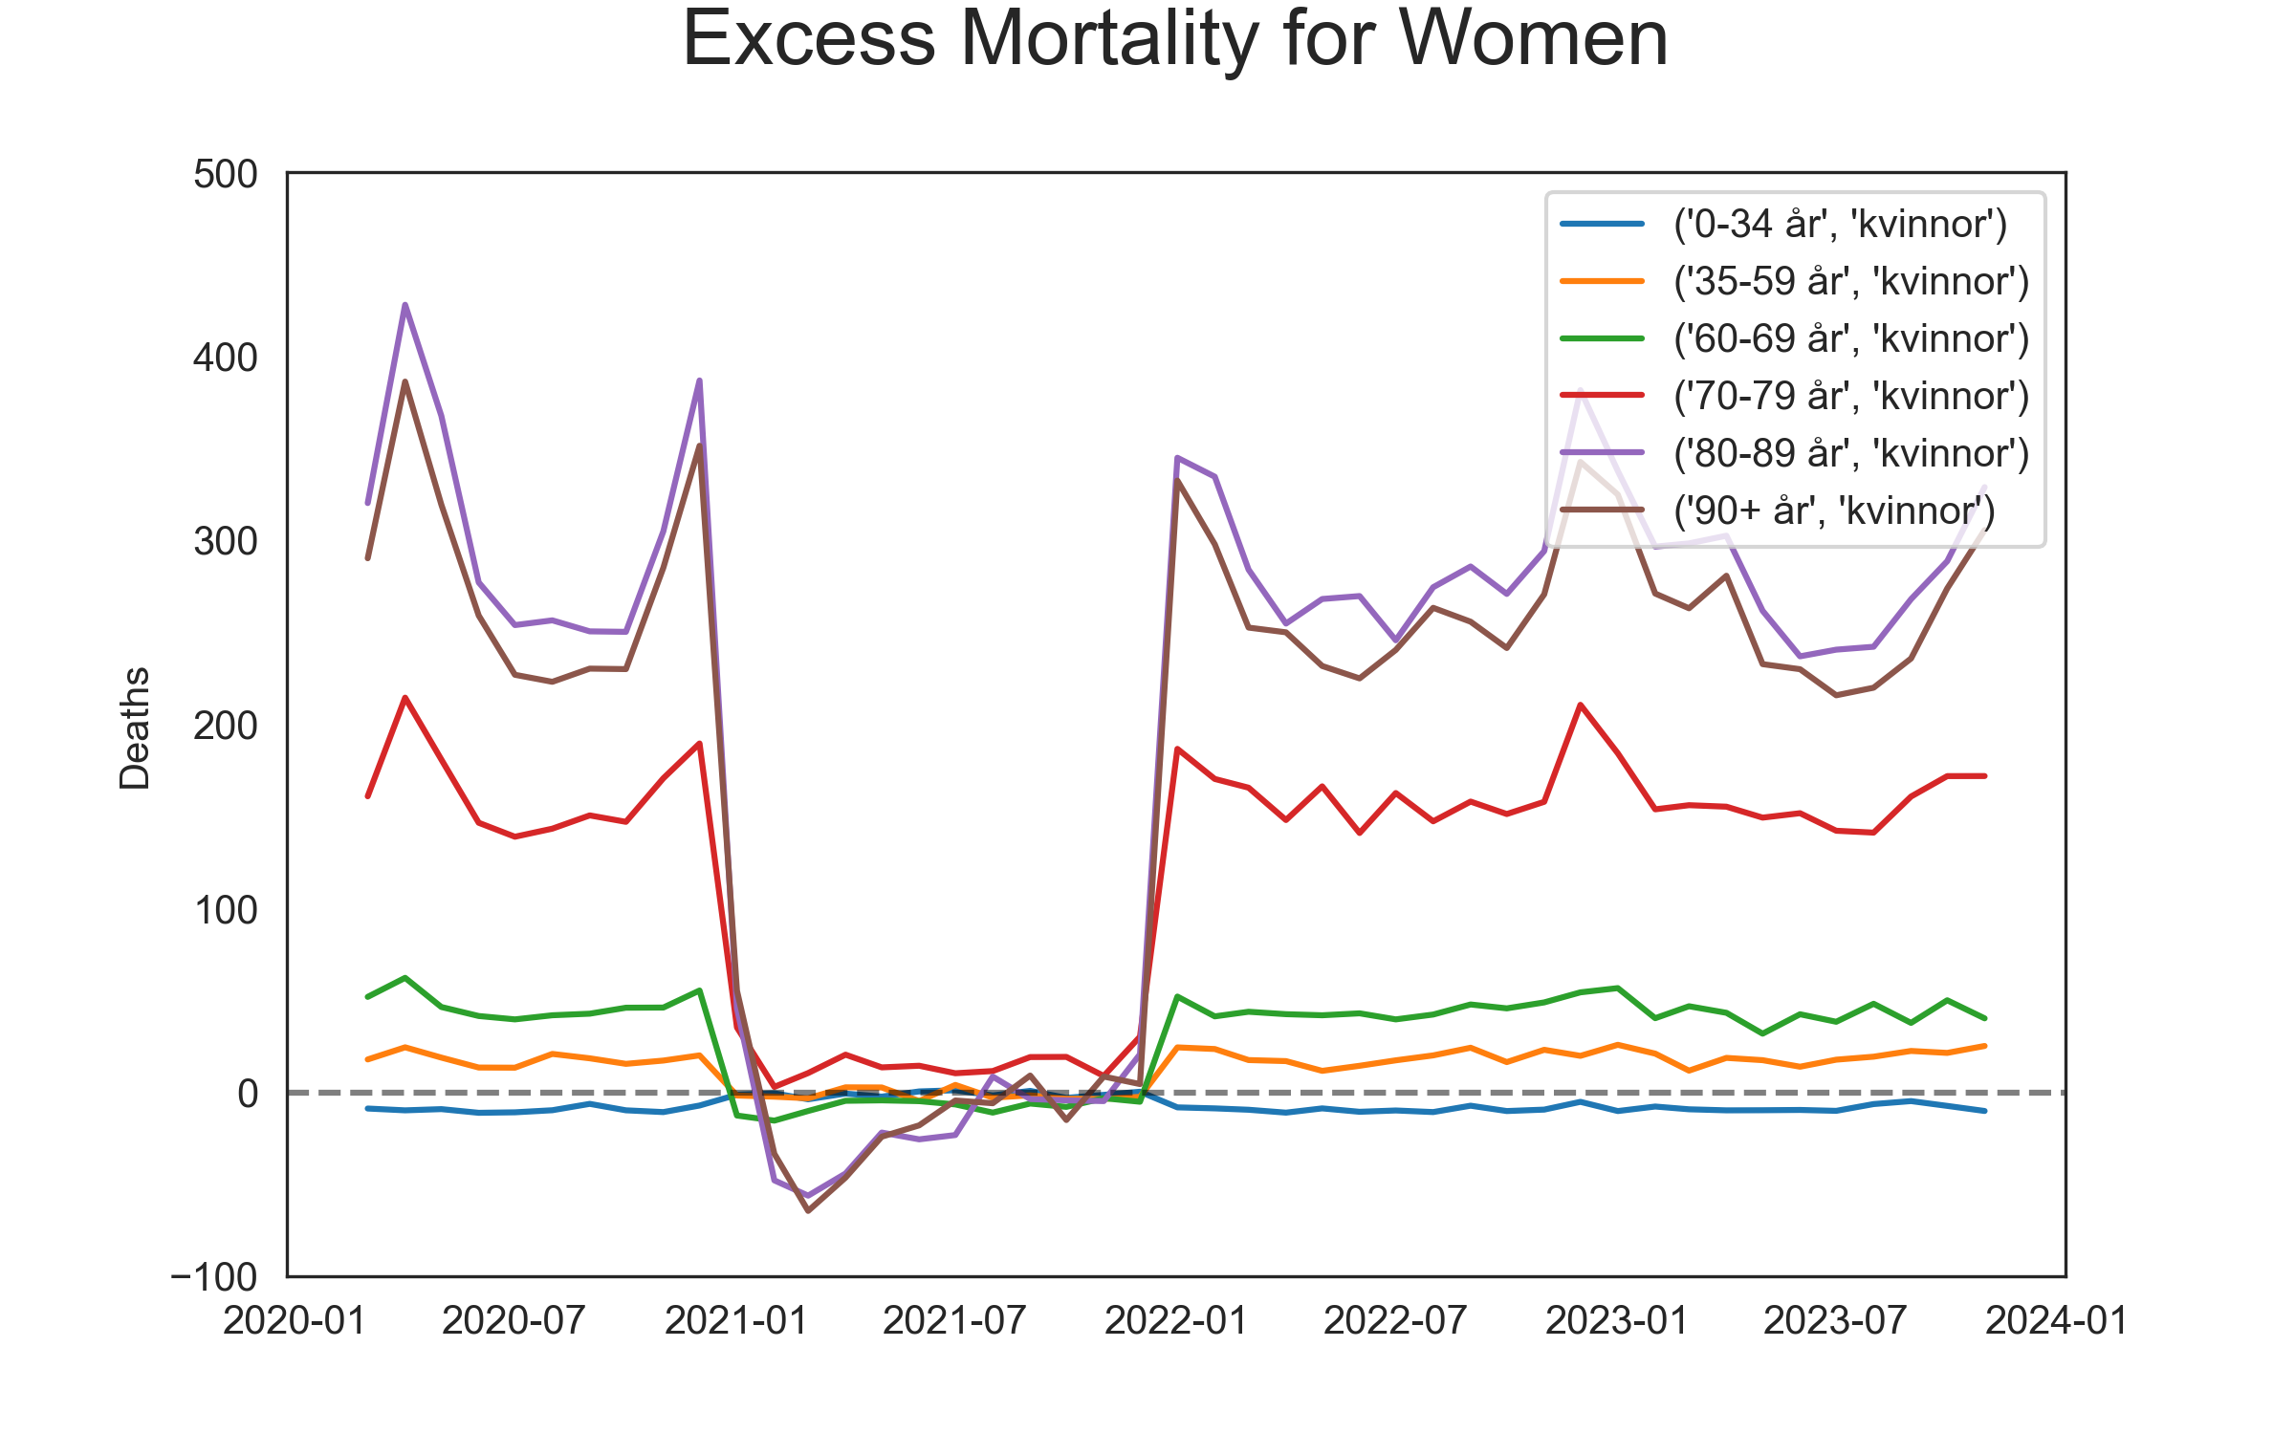
Data

Slide 27
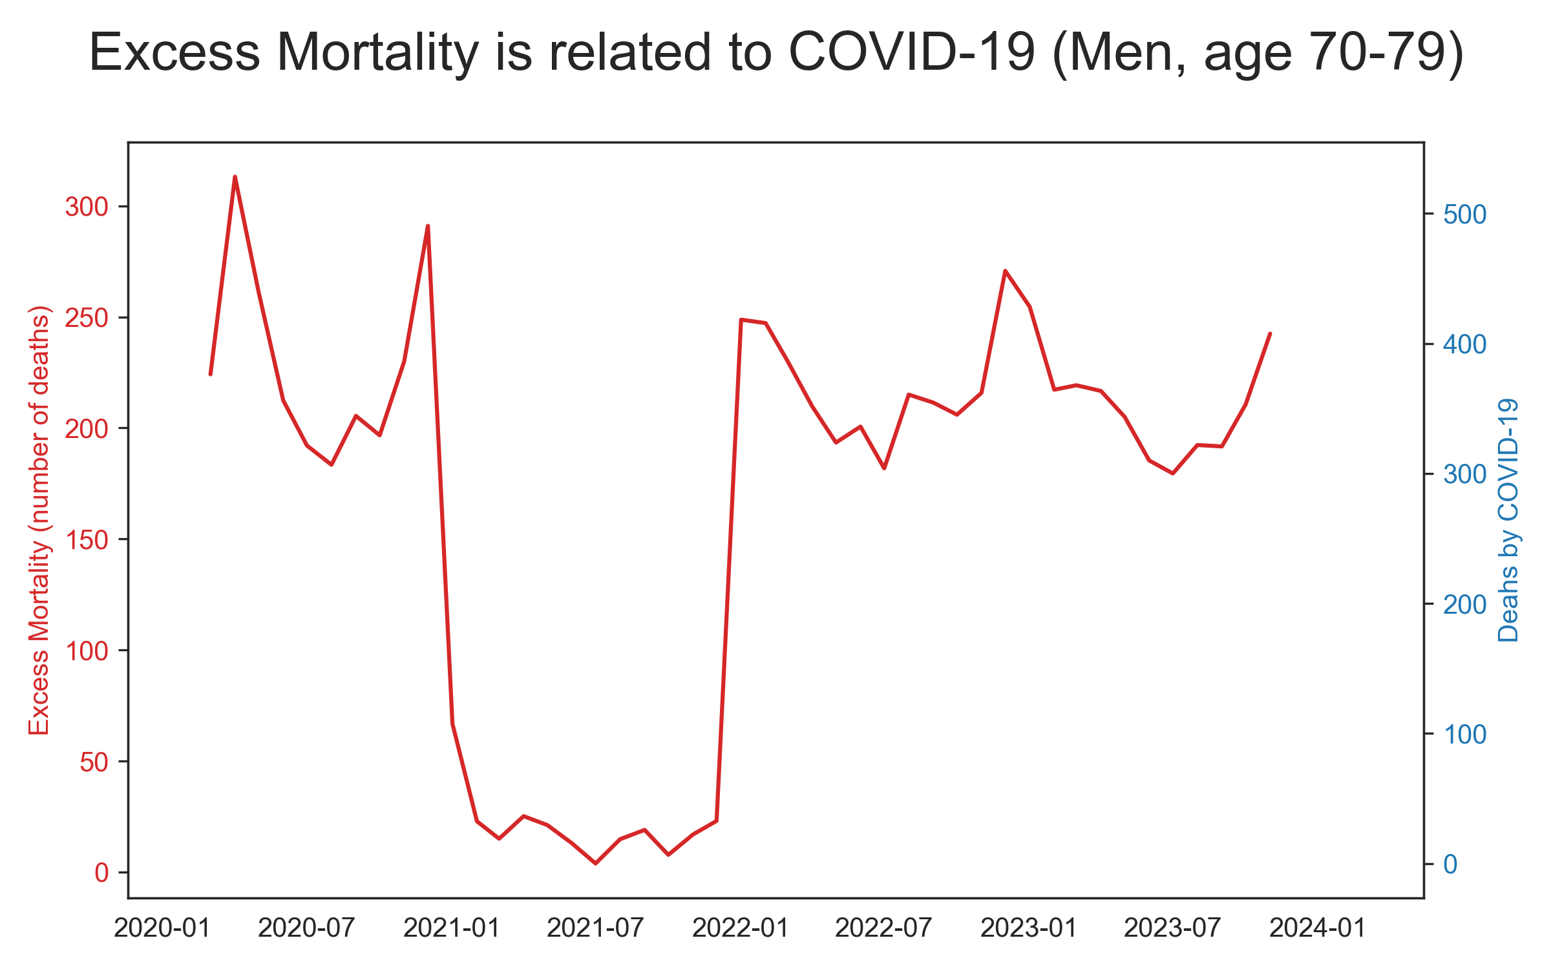
Data

Slide 28
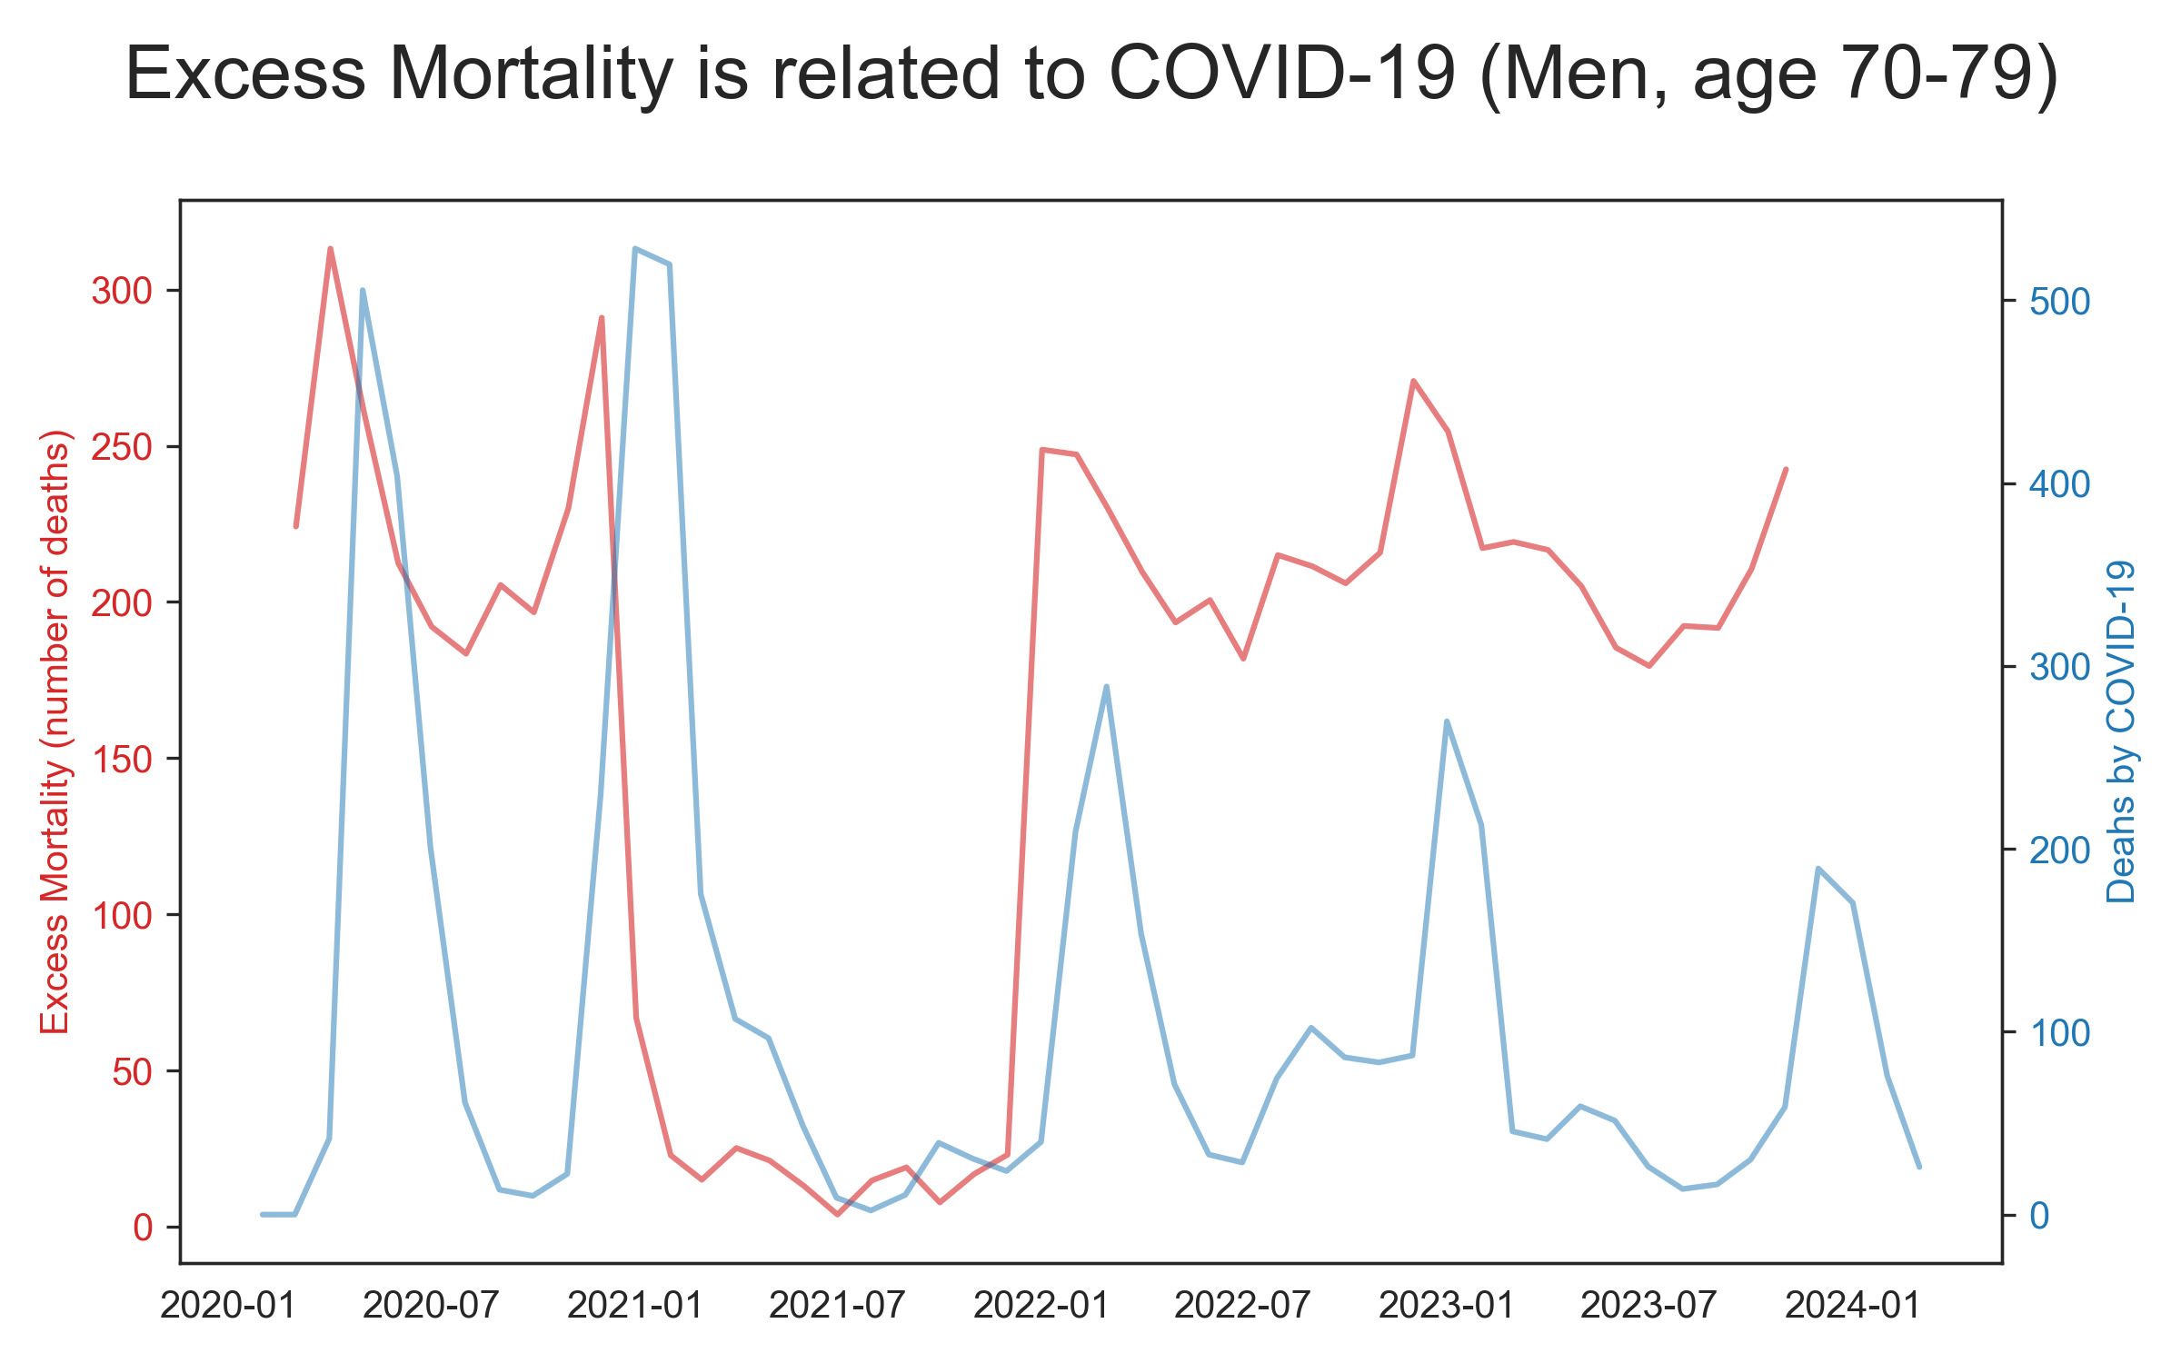
Data

Slide 29

Agenda
Cases
ICU and Death
Vaccination
Excess mortality
The Pandemic in 2024

Slide 30
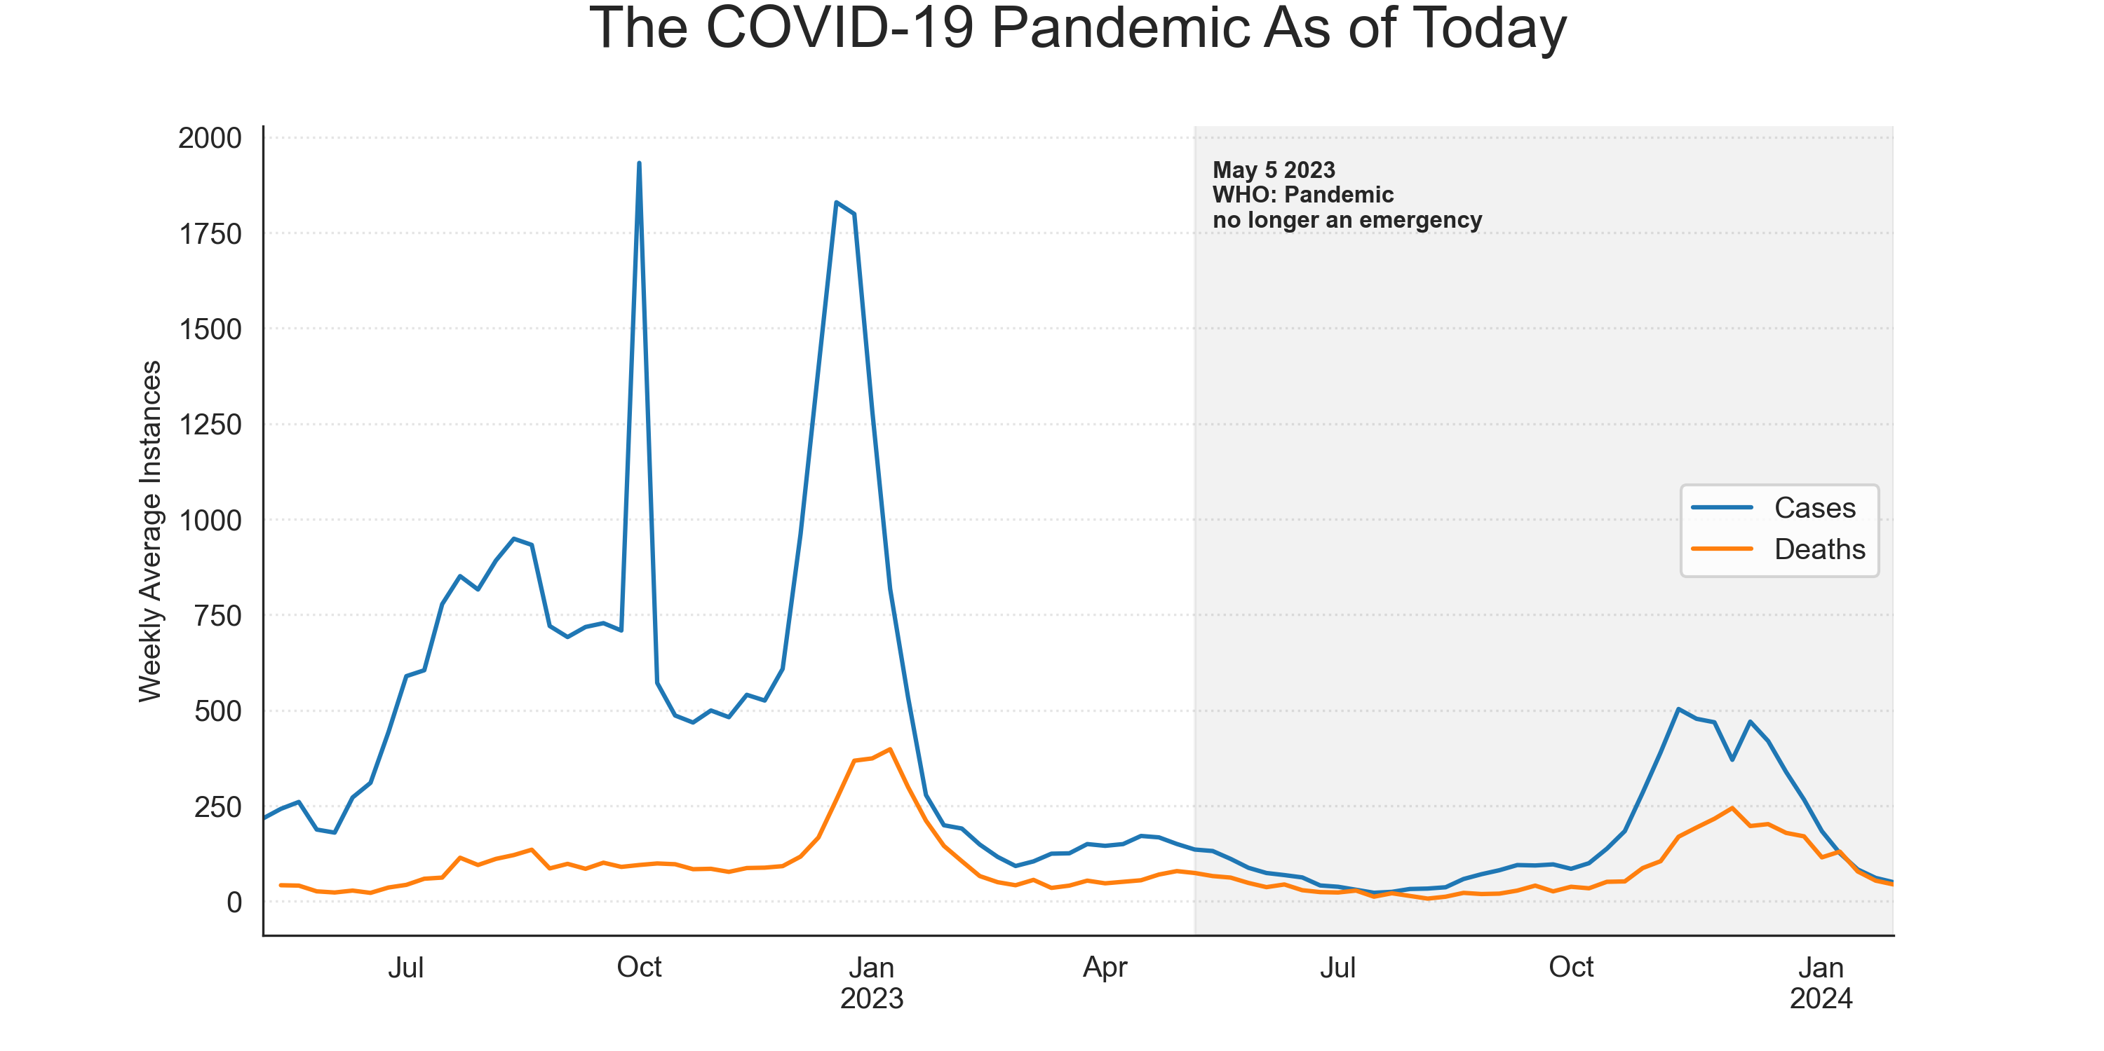
Data

Slide 31
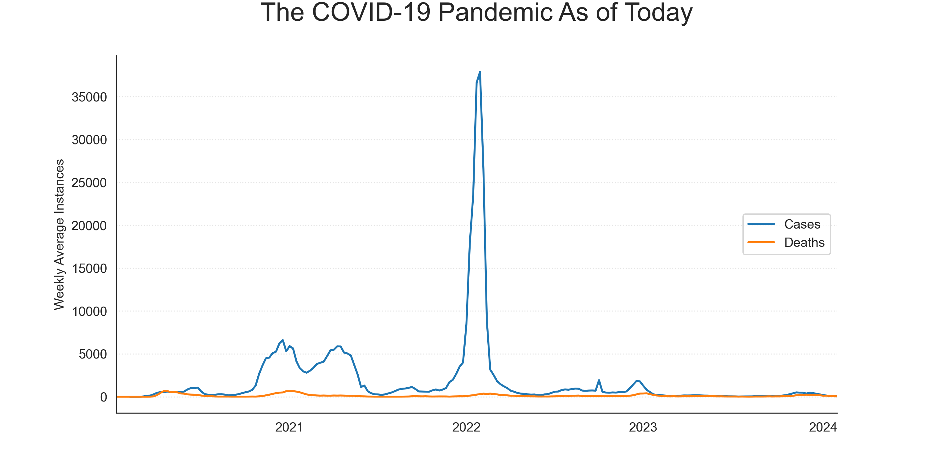
Data

